Slide 1
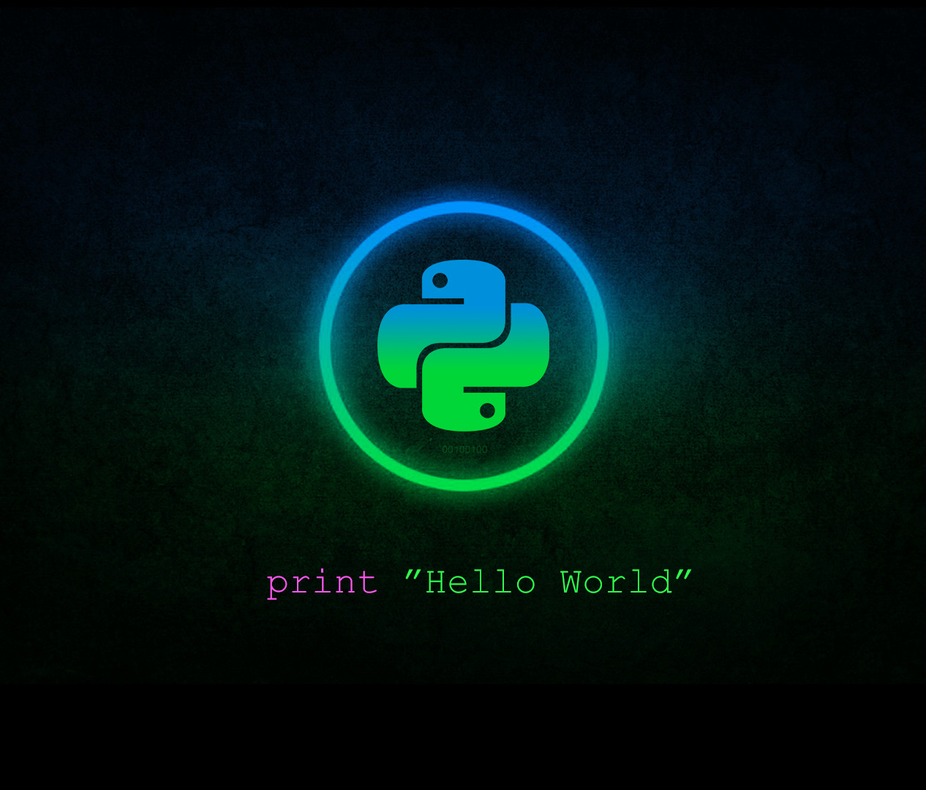



Python Basics
Class
viii
Lab 17
Supported by
Powered By

Slide 2
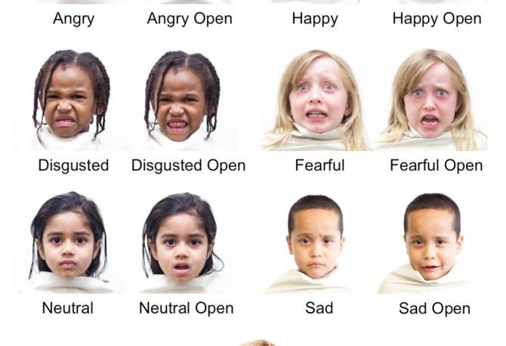
Expression
These are human expression
Supported by
Powered By

Slide 3
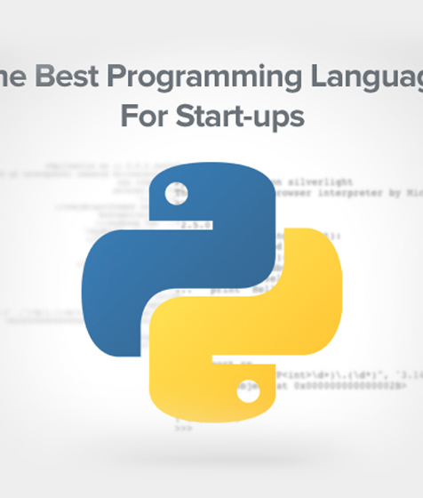
Expression in python
The best programming language for start ups
In python 2+2 is an expression, which is the most basic kind of programming instruction
Expressions consist of values (such as 2) and operators (such as +),
they can always evaluate down to a single value
2 + 2 is evaluated down to a single value, 4
A single value with no operators is also considered an expression
Supported by
Powered By

Slide 4
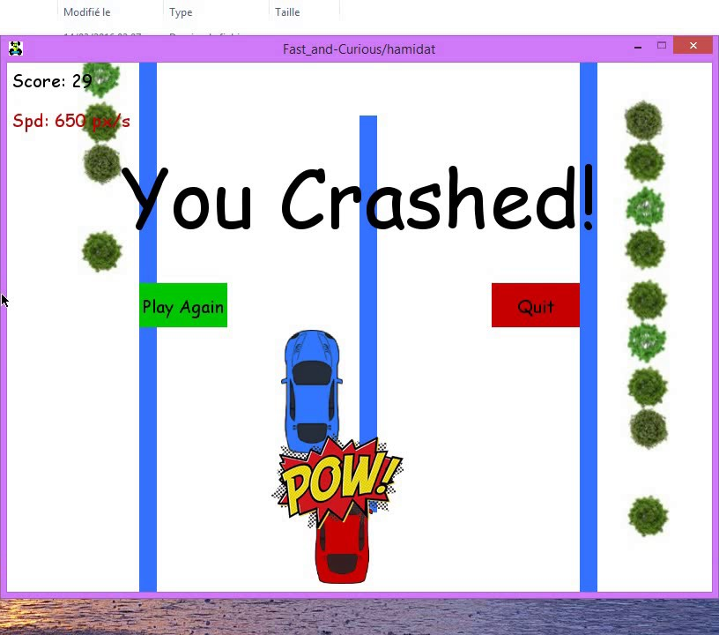
Crashing a program
Programs will crash if they contain code the computer can’t understand
Crashing a program shows you an error message
Error message won’t break your computer
So don’t be afraid to make mistakes.
A crash just means the program stopped running unexpectedly.
Supported by
Powered By

Slide 5
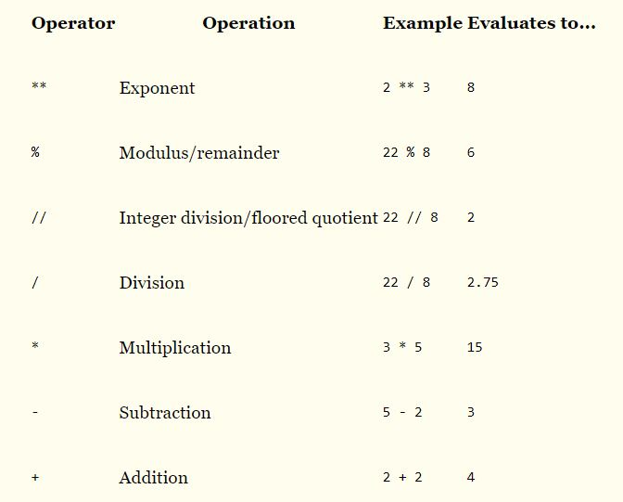
Mathematical Operator
The order of operations (also called precedence) of Python math operators is similar to that of mathematics.
Supported by
Powered By

Slide 6
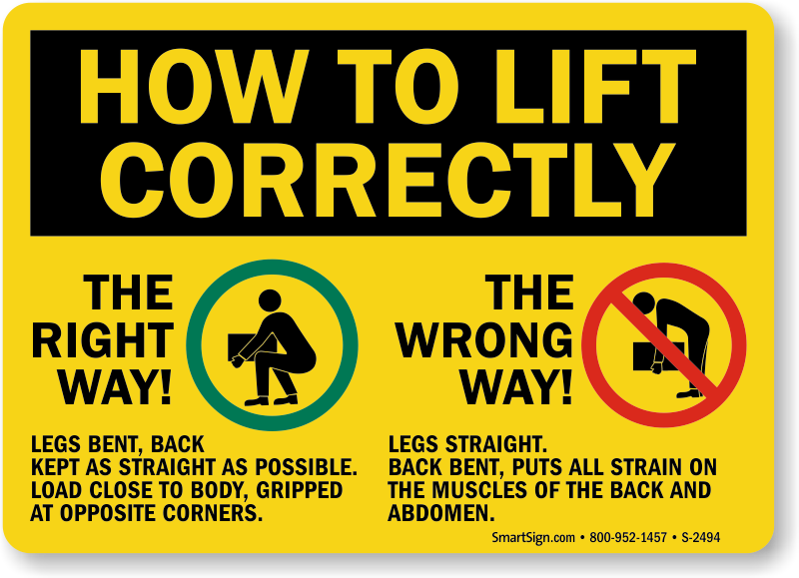
Bad Instruction
if you type in a bad Python instruction, Python won’t be able to understand it
The order of operations (also called precedence) of Python math operators is similar to that of mathematics.
Supported by
Powered By

Slide 7
SyntaxError
>>> 5 +
File "<stdin>", line 1
5 +
^
SyntaxError: invalid syntax
>>> 42 + 5 + * 2
File "<stdin>", line 1
42 + 5 + * 2
^
SyntaxError: invalid syntax
bad Python instruction shows a SyntaxError message
The order of operations (also called precedence) of Python math operators is similar to that of mathematics.
Supported by
Powered By

Slide 8

Thank You!
You’ll learn Data Types and Variable from next lab

